Slide 1
Connecting Laravel Project with MongoDB

Slide 2
Downloading and Installing MongoDb
Write mongodb on Google
Go to MongoDb Community Download
Download Mongodb Community Server

Slide 3
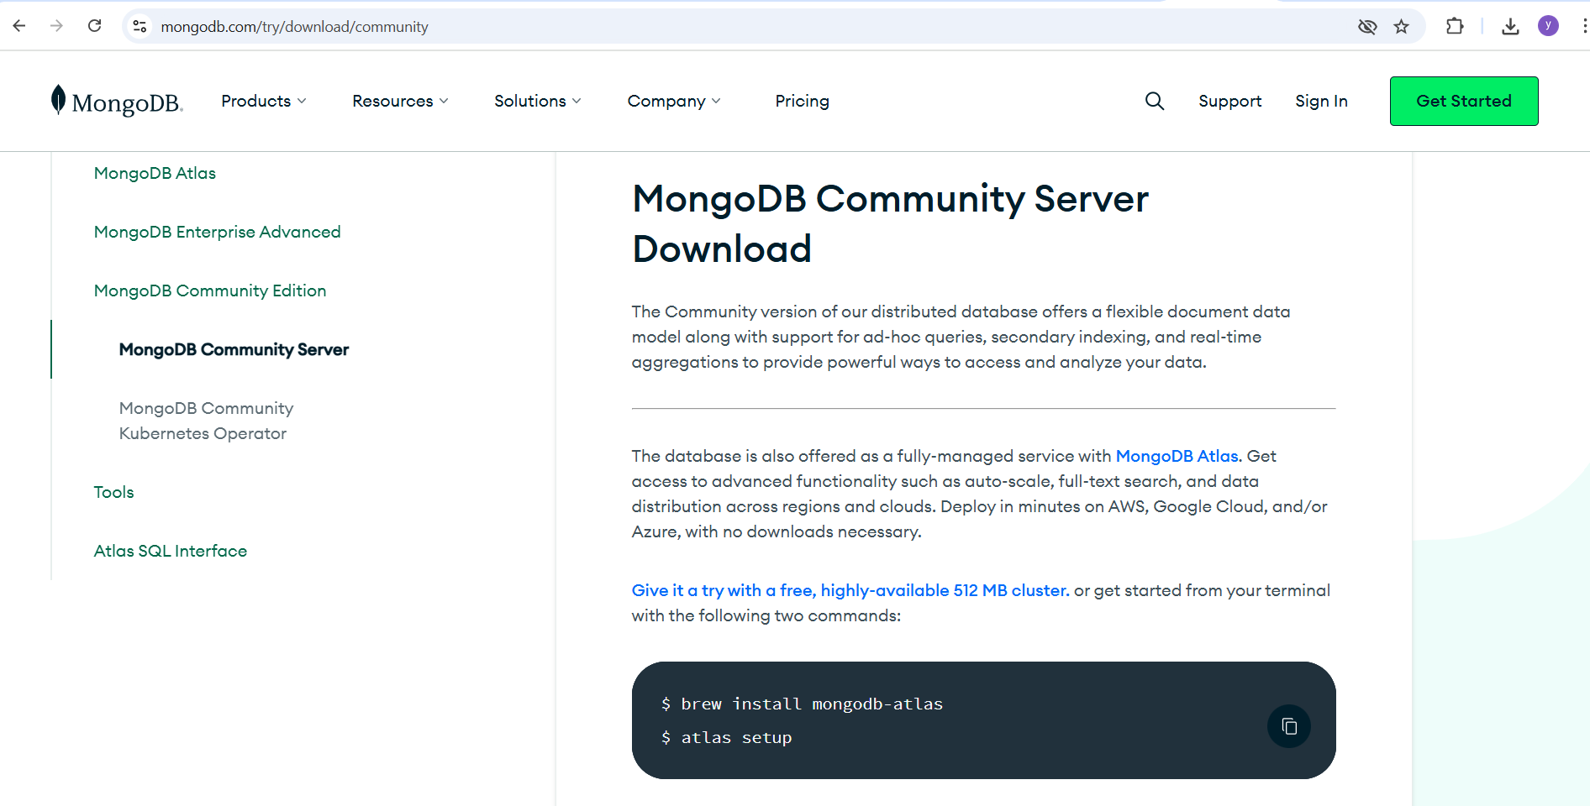
Install Mongodb Compass

Slide 4
php -i | findstr "PHP Version"
Check PHP Version
PHP Version => 8.2.12

Slide 5
php -i | findstr "Architecture"
Architecture => x64

Slide 6
php -i | findstr "Thread"
Thread Safety => enabled
Thread API => Windows Threads

Slide 7
Visit the PECL MongoDB Windows Downloads page.
Download the Appropriate php_mongodb.dll as per your version
Locate the DLL that matches your PHP version (8.0.30), architecture (x86 or x64), and thread safety (TS or NTS).​

Slide 8
Go to C:\xampp\php\ext
And Paste php_mongodb.dll

Slide 9
PHP VERSION
PHP Version | Compatible MongoDB Driver Versions | Notes
8.4 | 1.21.0 and above | Latest features
8.3 | 1.21.0 and above | Latest features
8.2 | 1.20.0 and above | Stable
8.1 | 1.19.0 and above | Stable
8.0 | Up to 1.20.x | Support dropped in 1.21.0
7.4 | Up to 1.20.x | Support dropped in 1.21.0

Slide 10
Download driver
Write php net mongodb (Mongodb- Manual –PHP)
Cick in Install the MongoDb Driver on Windows
Click on PECL
We will use version 1.8.1 (DLL File)
Use 7.4 Thread Safe * 64

Slide 11
php_mongodb_dl FIle
Copy the above file and paste in php -> C:\xampp\php\ext ext folder

Slide 12
Change in php.ini
Uncomment
extension=mongodb
Or Add extension=mongodb

Slide 13
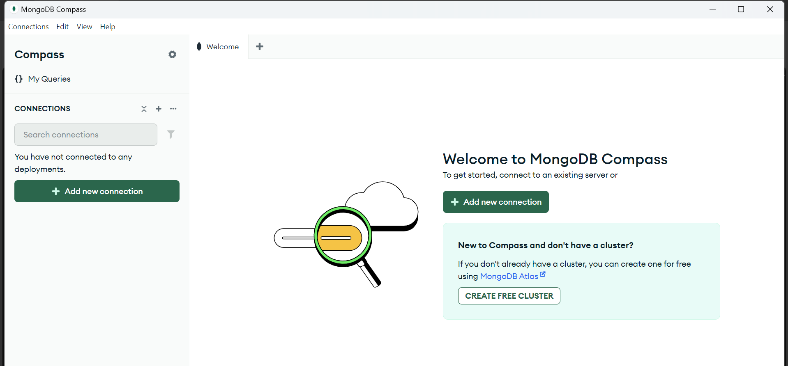
Open MongoDb Compass

Slide 14
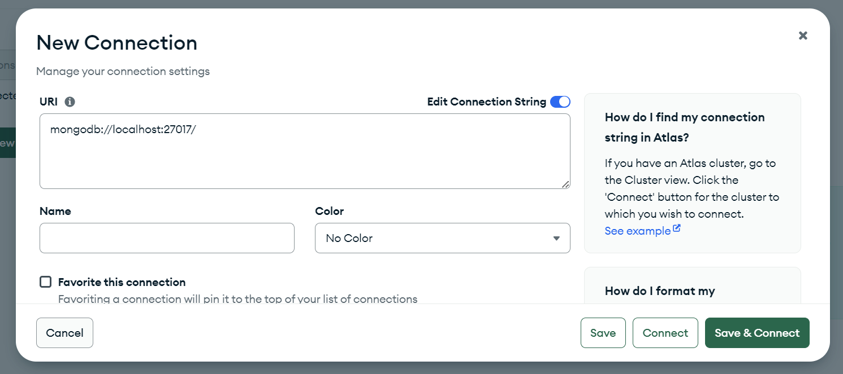
Go to Add new Connection –Write mongodb://localhost:27017/

Slide 15
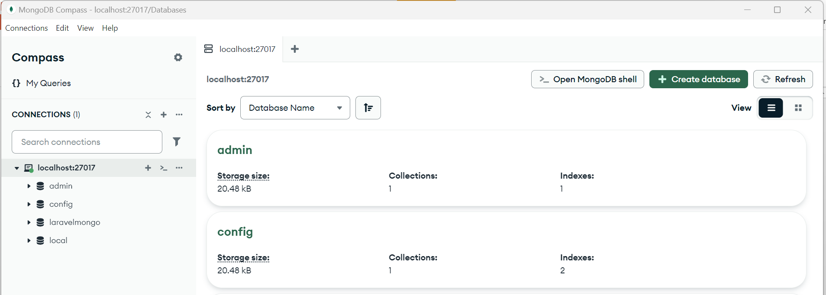
Click on Save and Connect Click on Create Database

Slide 16
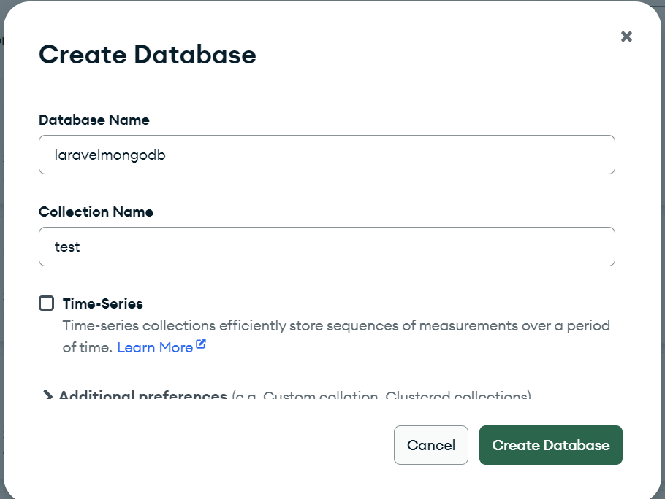
Create Db laravelmongodb and Collection test

Slide 17
C:\Program Files\MongoDB\Server\8.0\bin
Setting the Environment Variables

Slide 18
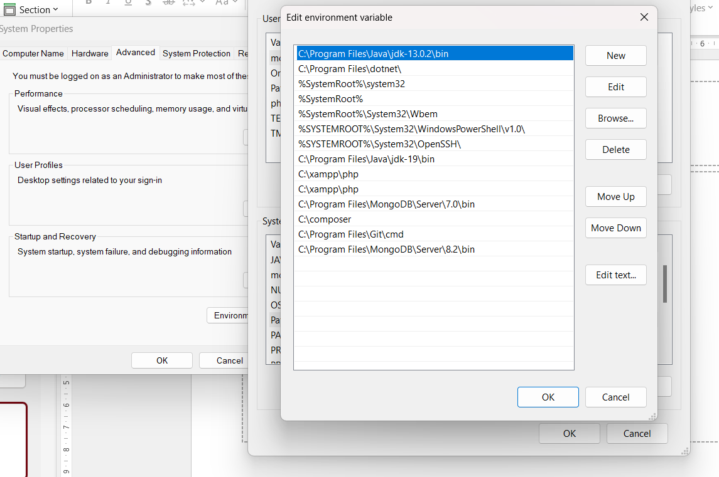
MongoDB Version

Slide 19
Add MongoDB to System PATH
Press Win + S and search for "Environment Variables"
Click on “Edit the system environment
variables”
In the System Properties window → click on
“Environment Variables…”
Under System variables, find and select
Path, then click Edit
Click New, and paste the path to your
MongoDB bin folder, e.g.:

Slide 20
For checking Mongodb
mongod --version

Slide 21
composer require mongodb/laravel-mongodb
Run above cmd

Slide 22
composer show mongodb/laravel-mongodb

Slide 23
composer config --global cafile "C:\xampp\php\extras\ssl\cacert.pem"
composer diagnose

Slide 24
Changes in .env file
DB_CONNECTION=mongodb
DB_HOST=127.0.0.1
DB_PORT=27017
DB_DATABASE=laravelmongo
DB_USERNAME=
DB_PASSWORD=
DB_AUTH_DATABASE=admin

Slide 25
Model File Student.php
<?php
namespace App\Models;
use MongoDB\Laravel\Eloquent\Model;
class Student extends Model
{
protected $connection = 'mongodb';
protected $collection = 'students';
protected $fillable = ['name', 'email', 'age'];
protected $guarded = []; // optional
}

Slide 26
Config->database.php
'mongodb' => [
'driver' => 'mongodb',
'host' => env('DB_HOST', '127.0.0.1'),
'port' => env('DB_PORT', 27017),
'database' => env('DB_DATABASE', 'laravelmongo'),
'username' => env('DB_USERNAME', ''),
'password' => env('DB_PASSWORD', ''),
'options' => [
'database' => env('DB_AUTH_DATABASE', 'admin'),
],
],

Slide 27
'default' => env('DB_CONNECTION', 'mongodb'),

Slide 28
StudentControl
use App\Models\Student;
class StudentControl extends Controller
{
/**
* Display a listing of the resource.
*/
public function index()
{
$students = Student::all();
return view('getstudents', compact('students'));
}

Slide 29
<table in blade
<table border="1">
<tr>
<th>Name</th>
<th>Email</th>
<th>Age</th>
</tr>
@foreach($students as $student)
<tr>
<td>{{ $student->name }}</td>
<td>{{ $student->email }}</td>
<td>{{ $student->age }}</td>
</tr>
@endforeach
</table>
</body

Slide 30
Add data in Mongodb
/** * Paste one or more documents here*/
{ "_id": {
"$oid": "6800bf7ddca90d91f6713fd6"
},
"name":"aman",
"email":"aman@gmail.com",
"age":40
}

